Slide 1
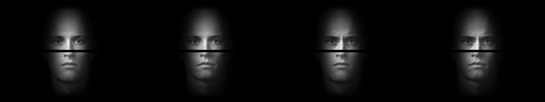
This experiment investigates how people perceive similarity between pairs of faces. Each face consists of a top half and bottom half. On each trial, you will be shown a pair of faces and asked to rate how similar the two faces are on an 8-point scale. Some examples of these faces are presented below.
You will be shown two faces at a time and asked to rate how similar the two faces are on an 8-point scale:
1 – 2 – 3 – 4 – 5 – 6 – 7 - 8
Least Similar -------------------Most Similar
A similarity score of 1 indicates that the two faces are NOT SIMILAR and a score of 8 means that the two faces are VERY SIMILAR.
As you can see, the faces are similar to each other because they are all bald headed men. However, the faces you will see will be even more similar to each other than the examples shown above. We want you to rate the similarity between the faces based on both the top and bottom half of each face
During the course of the experiment, please try to use all of the similarity scores (i.e., don’t just use scores of 1 and 8; try to make your scores use the entire range of responses).
There are a total of 720 different comparisons to make; it should only take 45-60 minutes to complete. Please try to use the entire scale. When you are ready, press SPACE to continue.

Slide 2
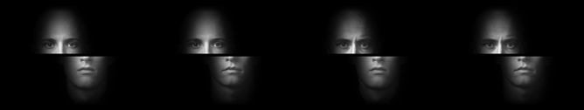
This experiment investigates how people perceive similarity between pairs of split faces. Each face consists of a misaligned top half and bottom half. On each trial, you will be shown a pair of split faces and asked to rate how similar the two faces are on an 8-point scale. Some examples of these split faces are presented below.
You will be shown two faces at a time and asked to rate how similar the two faces are on an 8-point scale:
1 – 2 – 3 – 4 – 5 – 6 – 7 - 8
Least Similar -------------------Most Similar
A similarity score of 1 indicates that the two faces are NOT SIMILAR and a score of 8 means that the two faces are VERY SIMILAR.
As you can see, the faces are similar to each other because they are all bald headed men. However, the faces you will see will be even more similar to each other than the examples shown above. We want you to rate the similarity between the faces based on both the top and bottom half of each face
During the course of the experiment, please try to use all of the similarity scores (i.e., don’t just use scores of 1 and 8; try to make your scores use the entire range of responses).
There are a total of 720 different comparisons to make; it should only take 45-60 minutes to complete. Please try to use the entire scale. When you are ready, press SPACE to continue.

Slide 3
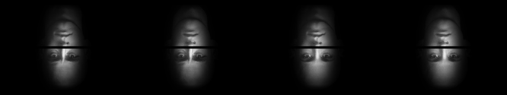
This experiment investigates how people perceive similarity between pairs of upside-down faces. Each face consists of a top and bottom half. On each trial, you will be shown a pair of upside-down faces and asked to rate how similar the two faces are on an 8-point scale. Some examples of these upside-down faces are presented below.
You will be shown two faces at a time and asked to rate how similar the two faces are on an 8-point scale:
1 – 2 – 3 – 4 – 5 – 6 – 7 - 8
Least Similar -------------------Most Similar
A similarity score of 1 indicates that the two faces are NOT SIMILAR and a score of 8 means that the two faces are VERY SIMILAR.
As you can see, the faces are similar to each other because they are all bald headed men. However, the faces you will see will be even more similar to each other than the examples shown above. We want you to rate the similarity between the faces based on both the top and bottom half of each face
During the course of the experiment, please try to use all of the similarity scores (i.e., don’t just use scores of 1 and 8; try to make your scores use the entire range of responses).
There are a total of 720 different comparisons to make; it should only take 45-60 minutes to complete. Please try to use the entire scale. When you are ready, press SPACE to continue.

Slide 4
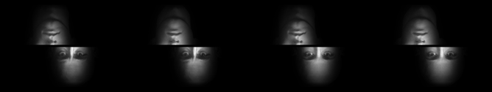
This experiment investigates how people perceive similarity between pairs of split upside-down faces. Each face consists of a misaligned top half and bottom half. On each trial, you will be shown a pair of split upside-down faces and asked to rate how similar the two faces are on an 8-point scale. Some examples of these split upside-down faces are presented below.
You will be shown two faces at a time and asked to rate how similar the two faces are on an 8-point scale:
1 – 2 – 3 – 4 – 5 – 6 – 7 - 8
Least Similar -------------------Most Similar
A similarity score of 1 indicates that the two faces are NOT SIMILAR and a score of 8 means that the two faces are VERY SIMILAR.
As you can see, the faces are similar to each other because they are all bald headed men. However, the faces you will see will be even more similar to each other than the examples shown above. We want you to rate the similarity between the faces based on both the top and bottom half of each face
During the course of the experiment, please try to use all of the similarity scores (i.e., don’t just use scores of 1 and 8; try to make your scores use the entire range of responses).
There are a total of 720 different comparisons to make; it should only take 45-60 minutes to complete. Please try to use the entire scale. When you are ready, press SPACE to continue.

Slide 5
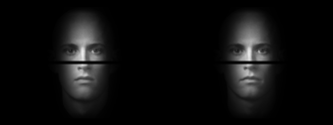
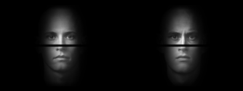
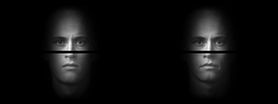
In the present task, you will be shown faces with a range of different similarities. For instance, an example such as the one which follows would be very similar
Consequently, this pair should receive a high rating (i.e., a 7 or an 8). On the other hand, this pair is highly dissimilar and should receive a low rating (i.e., a 1 or 2):
Finally, this pair has a similarity somewhere in the middle of the other two and should receive a middle rating (e.g., 4 or 5)
During the course of the experiment, please try to use all of the similarity scores. That is, don't just use scores of 1 and 8, try to make your scores using the entire range of responses.
Your goal is to respond as honestly as possible but bear in mind that the full range of similarities will be shown. If you have any questions, ask the experimenter now. Press SPACE to continue

Slide 6
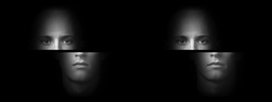
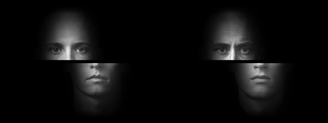
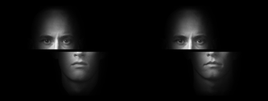
In the present task, you will be shown faces with a range of different similarities. For instance, an example such as the one which follows would be very similar
Consequently, this pair should receive a high rating (i.e., a 7 or an 8). On the other hand, this pair is highly dissimilar and should receive a low rating (i.e., a 1 or 2):
Finally, this pair has a similarity somewhere in the middle of the other two and should receive a middle rating (e.g., 4 or 5)
During the course of the experiment, please try to use all of the similarity scores. That is, don't just use scores of 1 and 8, try to make your scores using the entire range of responses.
Your goal is to respond as honestly as possible but bear in mind that the full range of similarities will be shown. If you have any questions, ask the experimenter now. Press SPACE to continue

Slide 7
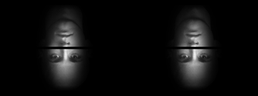
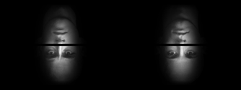
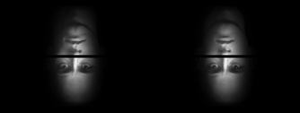
In the present task, you will be shown faces with a range of different similarities. For instance, an example such as the one which follows would be very similar
Consequently, this pair should receive a high rating (i.e., a 7 or an 8). On the other hand, this pair is highly dissimilar and should receive a low rating (i.e., a 1 or 2):
Finally, this pair has a similarity somewhere in the middle of the other two and should receive a middle rating (e.g., 4 or 5)
During the course of the experiment, please try to use all of the similarity scores. That is, don't just use scores of 1 and 8, try to make your scores using the entire range of responses.
Your goal is to respond as honestly as possible but bear in mind that the full range of similarities will be shown. If you have any questions, ask the experimenter now. Press SPACE to continue

Slide 8
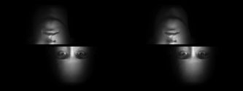
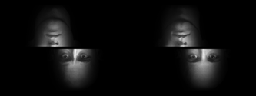

In the present task, you will be shown faces with a range of different similarities. For instance, an example such as the one which follows would be very similar
Consequently, this pair should receive a high rating (i.e., a 7 or an 8). On the other hand, this pair is highly dissimilar and should receive a low rating (i.e., a 1 or 2):
Finally, this pair has a similarity somewhere in the middle of the other two and should receive a middle rating (e.g., 4 or 5)
During the course of the experiment, please try to use all of the similarity scores. That is, don't just use scores of 1 and 8, try to make your scores using the entire range of responses.
Your goal is to respond as honestly as possible but bear in mind that the full range of similarities will be shown. If you have any questions, ask the experimenter now. Press SPACE to continue

